Slide 1
01100100 01100001 01110100 01100001 01100100 01100001 01110100 01100001 01100100 01100001 01110100 01100001 01100100 01100001 01110100 01100001 01100100 01100001 01110100 01100001 01100100 01100001 01110100 01100001 01100100 01100001 01110100 01100001 01100100 01100001 01110100 01100001 01100100 01100001 01110100 01100001 01100100 01100001 01110100 01100001 01100100 01100001 01110100 01100001 01100100 01100001 01110100 01100001 01100100 01100001 01110100 01100001 01100100 01100001 01110100 01100001 01100100 01100001 01110100 01100001 01100100 01100001 01110100 0110000101100100 01100001 01110100 01100001 01100100 01100001 01110100 01100001 01100100 01100001 01110100 01100001 01100100 01100001 01110100 01100001 01100100 01100001 01110100 01100001 01100100 01100001 01110100 01100001 01100100 01100001 01110100 01100001 01100100 01100001 01110100 01100001 01100100 01100001 01110100 01100001 01100100 01100001 01110100 01100001 01100100 01100001 01110100 01100001 01100100 01100001 01110100 01100001 01100100 01100001 01110100 01100001 01100100 01100001 01110100 01100001 01100100 01100001 01110100 01100001 01100100 01100001 01110100 01100001 01100100 01100001 01110100 01100001 01100100 01100001 01110100 01100001 01100100 01100001 01110100 01100001 01100100 01100001 01110100 01100001 01100100 01100001 01110100 01100001 01100100 01100001 01110100 01100001 01100100 01100001 01110100 01100001 01100100 01100001 01110100 01100001 01100100 01100001 01110100 01100001 01100100 01100001 01110100 01100001 01100100 01100001 01110100 01100001 01100100 01100001 01110100 01100001 01100100 01100001 01110100 01100001 01100100 01100001 01110100 01100001 01100100 01100001 01110100 01100001 01100100 01100001 01110100 01100001 01100100 01100001 01110100 01100001 01100100 01100001 01110100 01100001 01100100 01100001 01110100 01100001 01100100 01100001 01110100 01100001 01100100 01100001 01110100 01100001 01100100 01100001 01110100 01100001 01100100 01100001 01110100 01100001 01100100 01100001 01110100 01100001 01100100 01100001 01110100 01100001 01100100 01100001 01110100 01100001 01100100 01100001 01110100 01100001 01100100 01100001 01110100 01100001 01100100 01100001 01110100 01100001 01100100 01100001 01110100 01100001 01100100 01100001 01110100 01100001 01100100 01100001 01110100 01100001 01100100 01100001 01110100 01100001 01100100 01100001 01110100 01100001 01100100 01100001 01110100 01100001 01100100 01100001 01110100 01100001 01100100 01100001 01110100 01100001 01100100 01100001 01110100 01100001 01100100 01100001 01110100 01100001 01100100 01100001 01110100 01100001 01100100 01100001 01110100 01100001 01100100 01100001 01110100 01100001 01100100 01100001 01110100 01100001 01100100 01100001 01110100 01100001 01100100 01100001 01110100 01100001 01100100 01100001 01110100 01100001 01100100 01100001 01110100 01100001 01100100 01100001 01110100 01100001 01100100 01100001 01110100 01100001 01100100 01100001 01110100 01100001 01100100 01100001 01110100 01100001 01100100 01100001 01110100 01100001 01100100 01100001 01110100 01100001 01100100 01100001 01110100 01100001 01100100 01100001 01110100 01100001 01100100 01100001 01110100 01100001 01100100 01100001 01110100 01100001 01100100 01100001 01110100 01100001 01100100 01100001 01110100 01100001 01100100 01100001 01110100 01100001 01100100 01100001 01110100 01100001 01100100 01100001 01110100 01100001 01100100 01100001 01110100 01100001 01100100 01100001 01110100 01100001 01100100 01100001 01110100 01100001 01100100 01100001 01110100 01100001 01100100 01100001 01110100 01100001 01100100 01100001 01110100 01100001 01100100 01100001 01110100 01100001 01100100 01100001 01110100 01100001 01100100 01100001 01110100 01100001 01100100 01100001 01110100 01100001 01100100 01100001 01110100 01100001 01100100 01100001 01110100 01100001 01100100 01100001 01110100 01100001 01100100 01100001 01110100 01100001 01100100 01100001 01110100 01100001 01100100 01100001 01110100 01100001 01100100 01100001 01110100 01100001 01100100 01100001 01110100 0110000101100100 01100001 01110100 01100001 01100100 01100001 01110100 01100001 01100100 01100001 01110100 01100001 01100100 01100001 01110100 01100001 01100100 01100001 01110100 01100001 01100100 01100001 01110100 01100001 01100100 01100001 01110100 01100001 01100100 01100001 01110100 01100001 01100100 01100001 01110100 01100001 01100100 01100001 01110100 01100001 01100100 01100001 01110100 01100001 01100100 01100001 01110100 01100001 01100100 01100001 01110100 01100001 01100100 01100001 01110100 01100001 01100100 01100001 01110100 01100001 01100100 01100001 01110100 01100001 01100100 01100001 01110100 01100001 01100100 01100001 01110100 01100001 01100100 01100001 01110100 01100001 01100100 01100001 01110100 01100001 01100100 01100001 01110100 01100001 01100100 01100001 01110100 01100001 01100100 01100001 01110100 01100001 01100100 01100001 01110100 01100001 01100100 01100001 01110100 01100001 01100100 01100001 01110100 01100001 01110100 01100001 01100100 01100001 01110100 01100001
Andrea Glorioso, Counsellor (Digital Economy / Cyber)
Jeff Chen, Chief Data Scientist

Slide 2
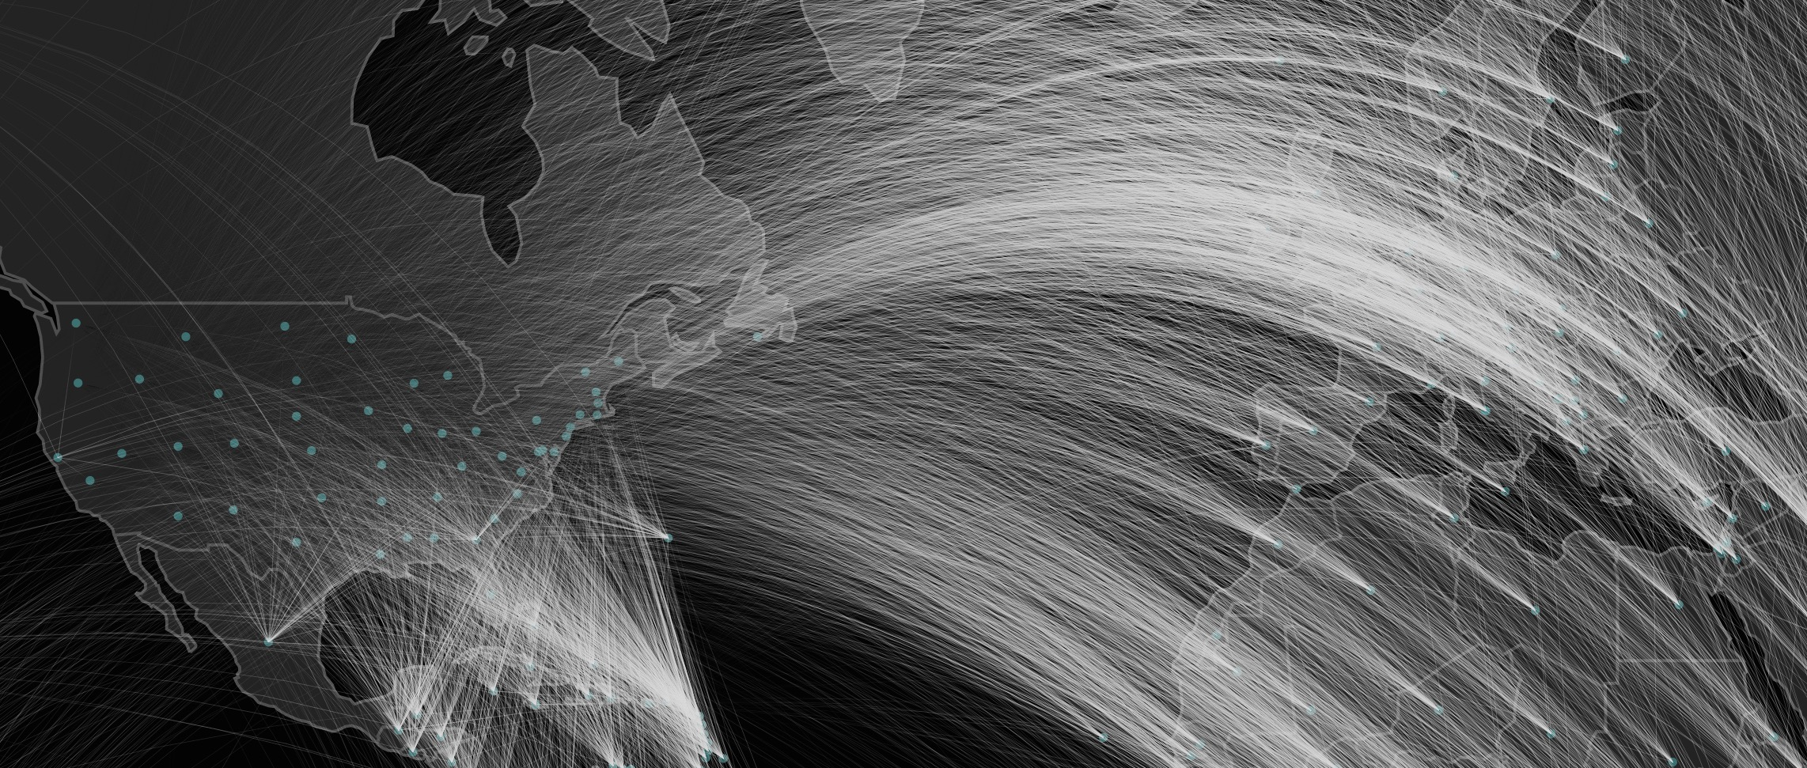
Global Trade Flows
Notes:
The European Union and the United States have some of the most important data, collectively characterizing the lives of over one billion people.
And much of that data is open — open data is engrained in all we do, from advanced research to economic dialogue.
Open data doesn’t mean comparable data, as its rooted in our unique histories and cultures.
But cooperation and comparability are the foundations of a stronger, more prosperous relationship.
That’s why we’ve established a trans-atlantic open data partnership between the EU and US.

Slide 3
Notes:
Step 1: What’s TrulyTrans-Atlantic
Through this partnership we aim to create new opportunity from open economic data. To get there, we need to start by first experimenting and prototyping a model for how EU and US data can be used together.
In order to enable a user centered culture, we must first establish a cohesive economic dataset on both sides of the Atlantic.
We’ve laid out a three step process to move towards comparable open data. First, we’re working to determine which economic data series are truly trans-Atlantic.
Over the past couple of months, economists from European Union’s Eurostat and the US’ Bureau of Economic Analysis have been working to understand where our economic indicators line up, whether across cities and metropolitan areas or by economic classifications.
From this common ground we can build a consistent vision for how economic data can be represented and generalized across the EU and the US.

Slide 4
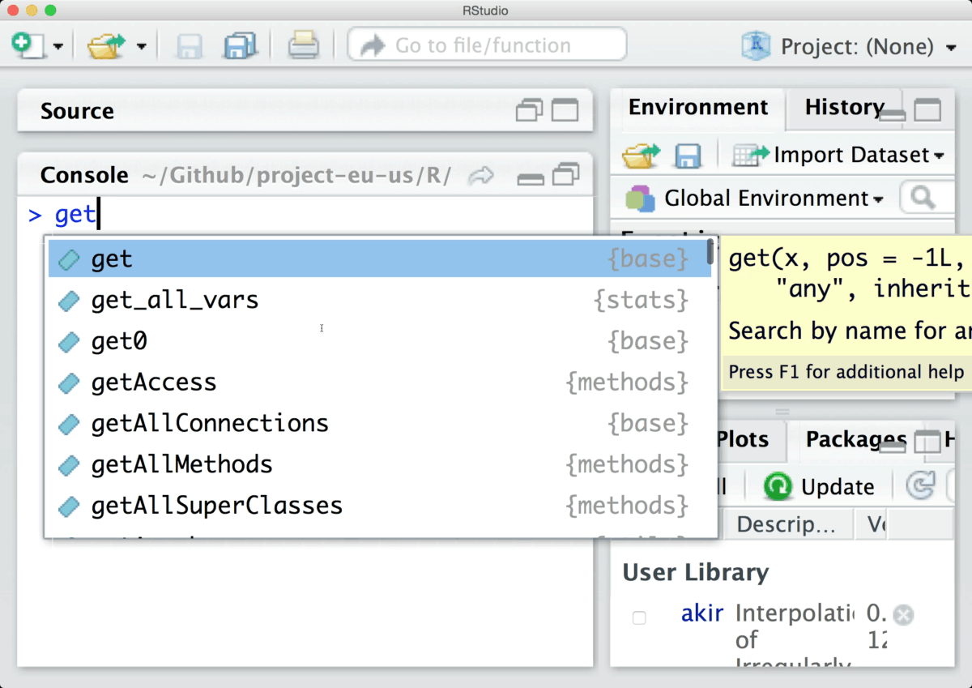

harmonized results
ETL
ETL
ETL
input
Notes:
Slide 3: R Library
It takes time to perfect that vision. But we can move closer to perfection through iterative prototyping. And we believe that the first step would be to operationalize a code library that pulls similar data series from different data producers.
Building upon the BEA R Library concept, Eurostat and BEA data scientists and engineers are developing a new R library that draws data from our respective APIs
With relatively few lines of code, imagine being able to search for data from two international statistical agencies and extract a harmonized data pull
We’re learning a lot about the Extract-Transform-Load processes we need to design and need to be codified in the metadata so that a seamless linked open data approach is possible
We're learning a lot about how we can work together on common code bases
We're learning and discovering what a transatlantic capability really means

Slide 5
Notes:
Slide 4: Open Data Users
With version scheduled for completion in the coming weeks, we will have a basis to engage and understand what the open data community needs, now that a harmonized data is possible
What are the pain points we can solve together so that data can be a catalyst for greater cooperation?
In the coming weeks, we need your help. We want to understand how an EU-US partnership on economic data can improve research and encourage dialogue.

